Slide 1

STOCK PORTFOLIO MANAGEMENT
DATA 606 CAPSTONE PROJECT
STOCK PORTFOLIO MANAGEMENT
WELCOME TO MY PRESENTATION
GUIDED BY: DR JAY WANG (PROF. UMBC)
PRESENTER: SAI KARTEEK EDUMUDI

Slide 2

TABLE OF CONTENTS
01
02
03
04
INTRODUCTION
MODEL AND METRICS
PROBLEM AND SOLUTION
APPLICATION DEMO
02

Slide 3

INTRODUCTION
THE AIM OF THIS PROJECT IS TO BUILD A TOOL WHICH HELPS STOCK MARKET INVESTORS TO MANAGE THEIR PORTFOLIO RISK BY ANALYSING THE APPLICATION RESULTS AND IMPLIMENT BEST PRACTISES TO MITIGATE RISK.

Slide 4

Background
Efficient Market Hypothesis is the popular theory about stock prediction. With its failure much research has been carried in the area of prediction of stocks. This project is about taking non quantifiable data such as financial news articles about a company and predicting its future stock trend with news sentiment classification, prediction and trend analysis. Assuming the news articles have impact on stock market, this is an attempt to study relationship between news and stock trend. To show this, we created three different models one which depicts polarity of news articles being positive or negative, one classifier to predict movement and regression model to predict the expected closing price. Observations show that RF and DT, KNN perform well in all types of testing. Facebook Prophet model which predicts the trend of the stock. Experiments are conducted to evaluate various aspects of the proposed model and encouraging results are obtained in all the experiments. The accuracy of the overall model is more than 80% as it uses multiple models for providing final estimate.

Slide 5

PROBLEM and SOLUTION
Motivation, Problem Statement and Solution

Slide 6

PROBLEM
In the finance field, stock market and its trends are extremely volatile in nature. It attracts researchers to find techniques in capturing the volatility and predicting its next moves. Investors and market analysts study the market behavior and plan their buy or sell strategies accordingly. As stock market produces large amount of data every day, it is very difficult for an individual to consider all the current and past information for predicting future trend of a stock. Mainly there are two methods for forecasting market trends. One is Technical analysis and other is Fundamental analysis. Technical analysis considers past price and volume to predict the future trend whereas fundamental analysis On the other hand, Fundamental analysis of a business involves analyzing its financial data to get some insights. The efficacy of both technical and fundamental analysis is disputed by the efficient-market hypothesis which states that stock market prices are essentially unpredictable.

Slide 7

SOLUTION
We assumed that news articles and stock price are related to each other and, news may have capacity to fluctuate stock trend. So, we thoroughly studied this relationship and concluded that stock trend can be predicted using news articles and previous price history. As news articles capture sentiment about the current market, we automate this sentiment detection and based on the words in the news articles, we can get an overall news polarity. If the news is positive, then we can compare with the closing price to verify that the news impact is good in the stock market, so more chances of stock price go high. And if the news is negative, then it may impact the stock price to go down in trend.

Slide 8
MODELS AND METRICS
Name
Random Forest Regressor | 6.0515(Root Mean Squared Error)
K Nearest Neighbor | 76.15% (accuracy score)
Decision Tree | 65.03 (accuracy score)
Decision Tree Regressor | 8.873(Root Mean Squared Error)

Slide 9
APPLICATION STRUCTURE
INTRODUCTION
PREDICTIONS
NEWS SENTIMENT
NEWS ARTICLES AND LINKS
MODEL METRICS
TREND

Slide 10

APPLICATION OVERVIEW
APPLICATION OVERVIEW:
THIS PAGE CONTAINS INFORMATION ABOUT PRODUCT, MODELS AND EVALUATION, DATASET USED, AND PLOTS.
PREDICTIONS:
THIS PAGE CONTAINS INFORMATION ABOUT PREDICTIONS, TREND, NEWS ARTICLES WITH LINKS.

Slide 11

Charts

Slide 12
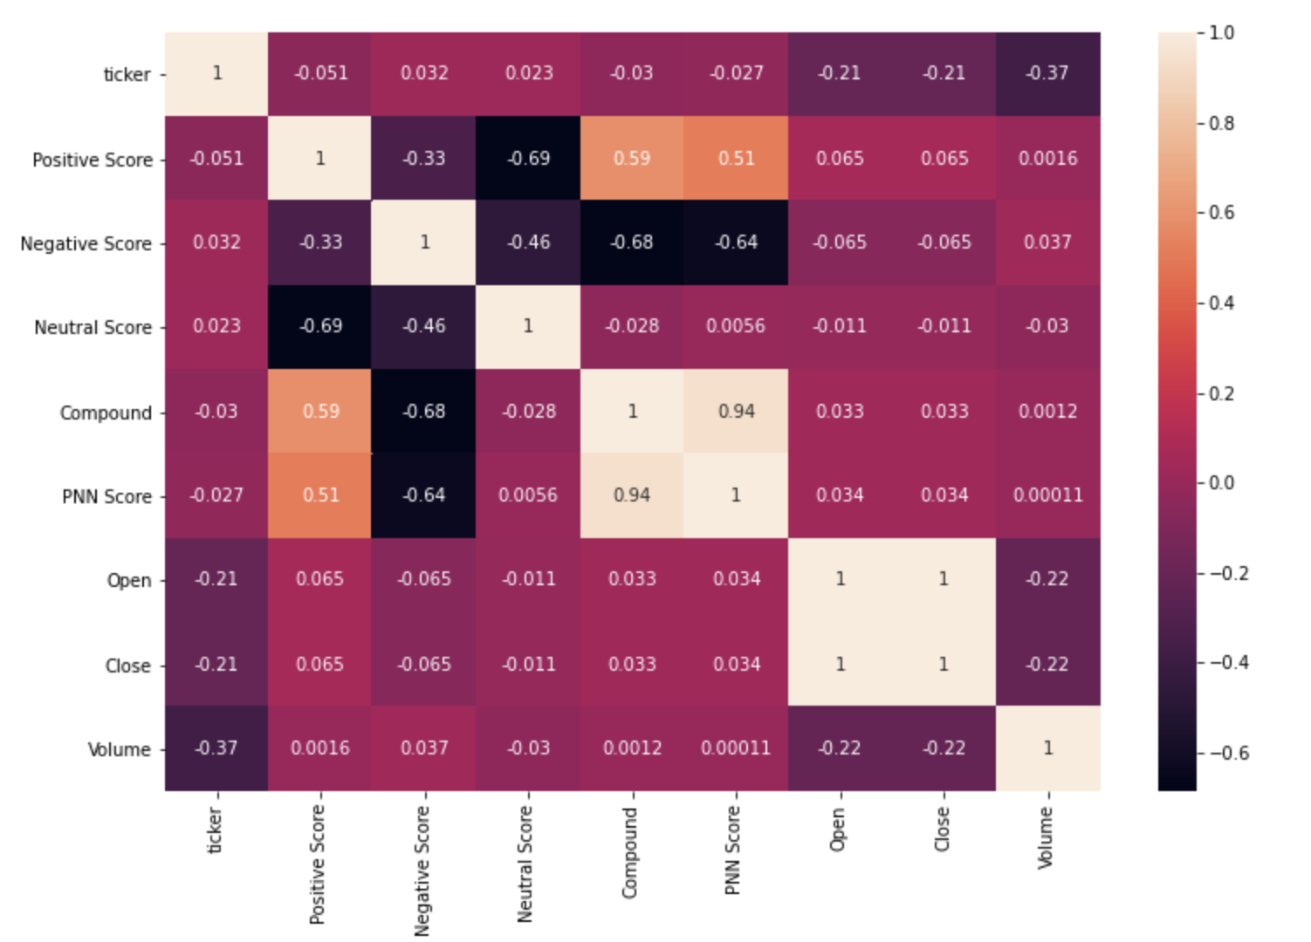
HEATMAP FOR CO-RELATION

Slide 13
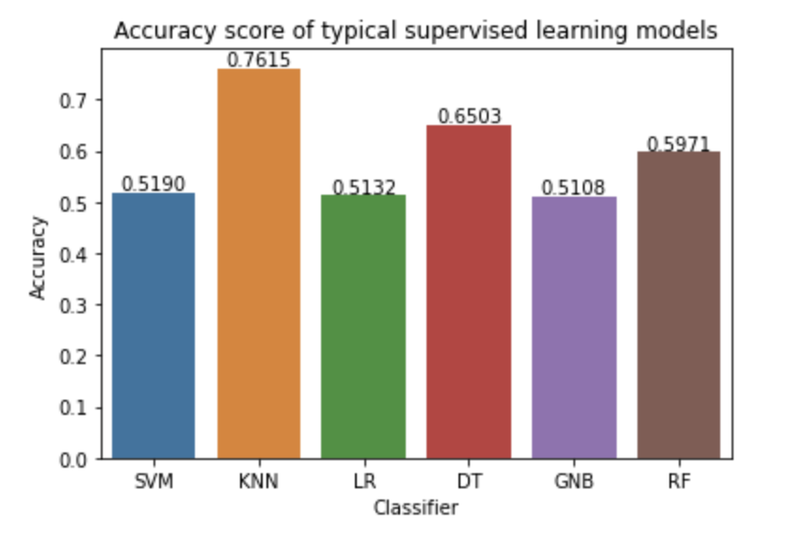
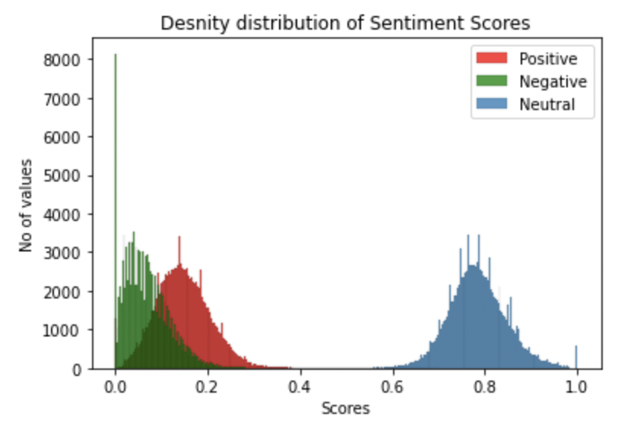
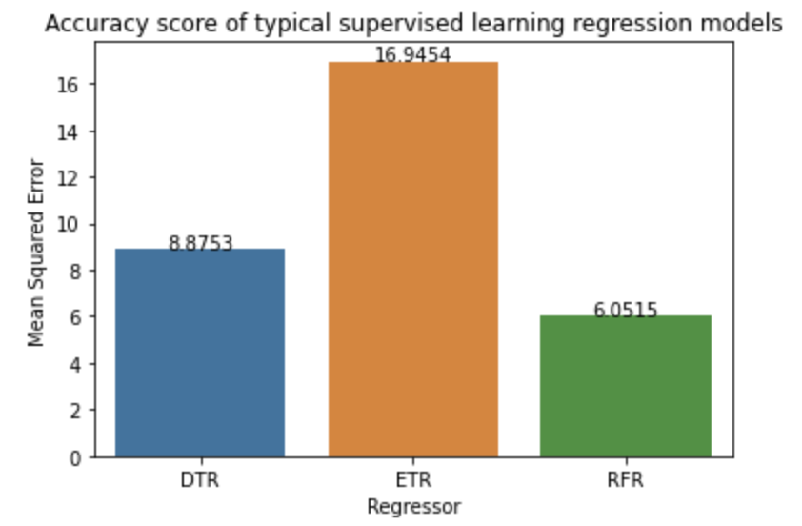
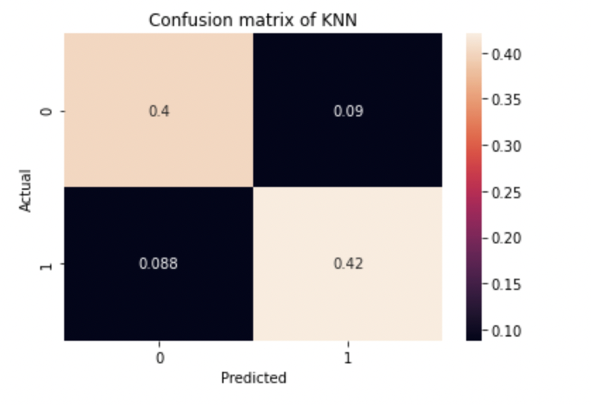

Slide 14
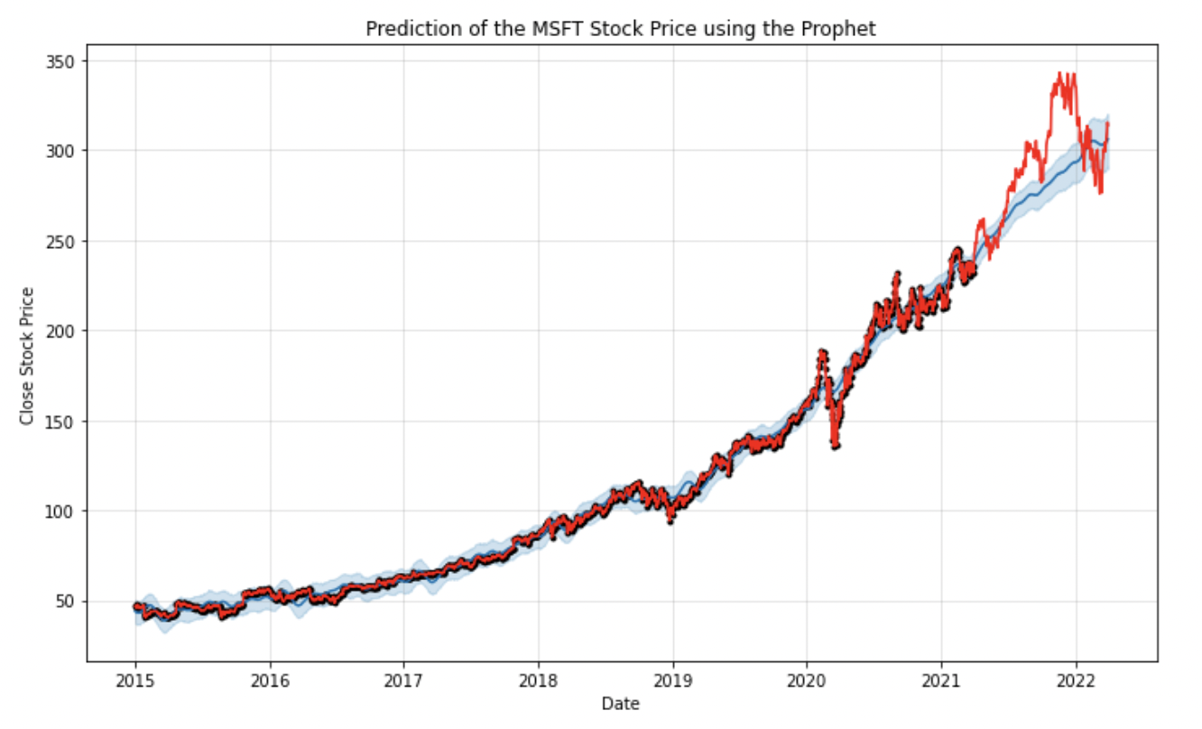
YEARLY TREND ANALYSIS

Slide 15
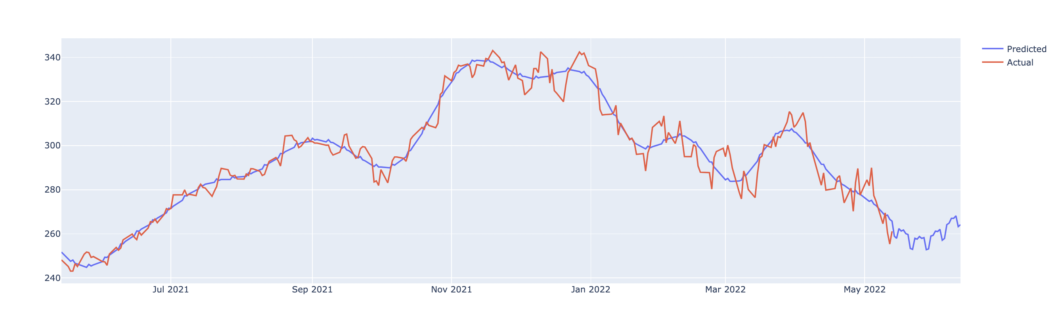

PIE CHART FOR SENTIMENT PERCENTAGES
MONTLY TREND ANALSIS
MONTHLY TREND AND SENTIMENT

Slide 16

PRODUCT DEMO

Slide 17
THANK YOU

